Slide 1
Transmission Subsystem
Recep GÜNAY

Slide 2
Problem Statement and Requirements
Latency
Low latency
Interference
Interference free

Slide 3
Solutions

Slide 4
Solutions
Latency:
Analog video data
Trade-off between quality
Interference:
Circular Polarized Waves
Low signal power
Multiple channels in different bands

Slide 5
Test Results
Range:
200m in line of sight
40m with obstacles
Interference:
No multipath interference
No interference with another system in different channels
Latency:
Less than 80ms within a 10m radius
Up to 200ms at around 30m

Slide 6
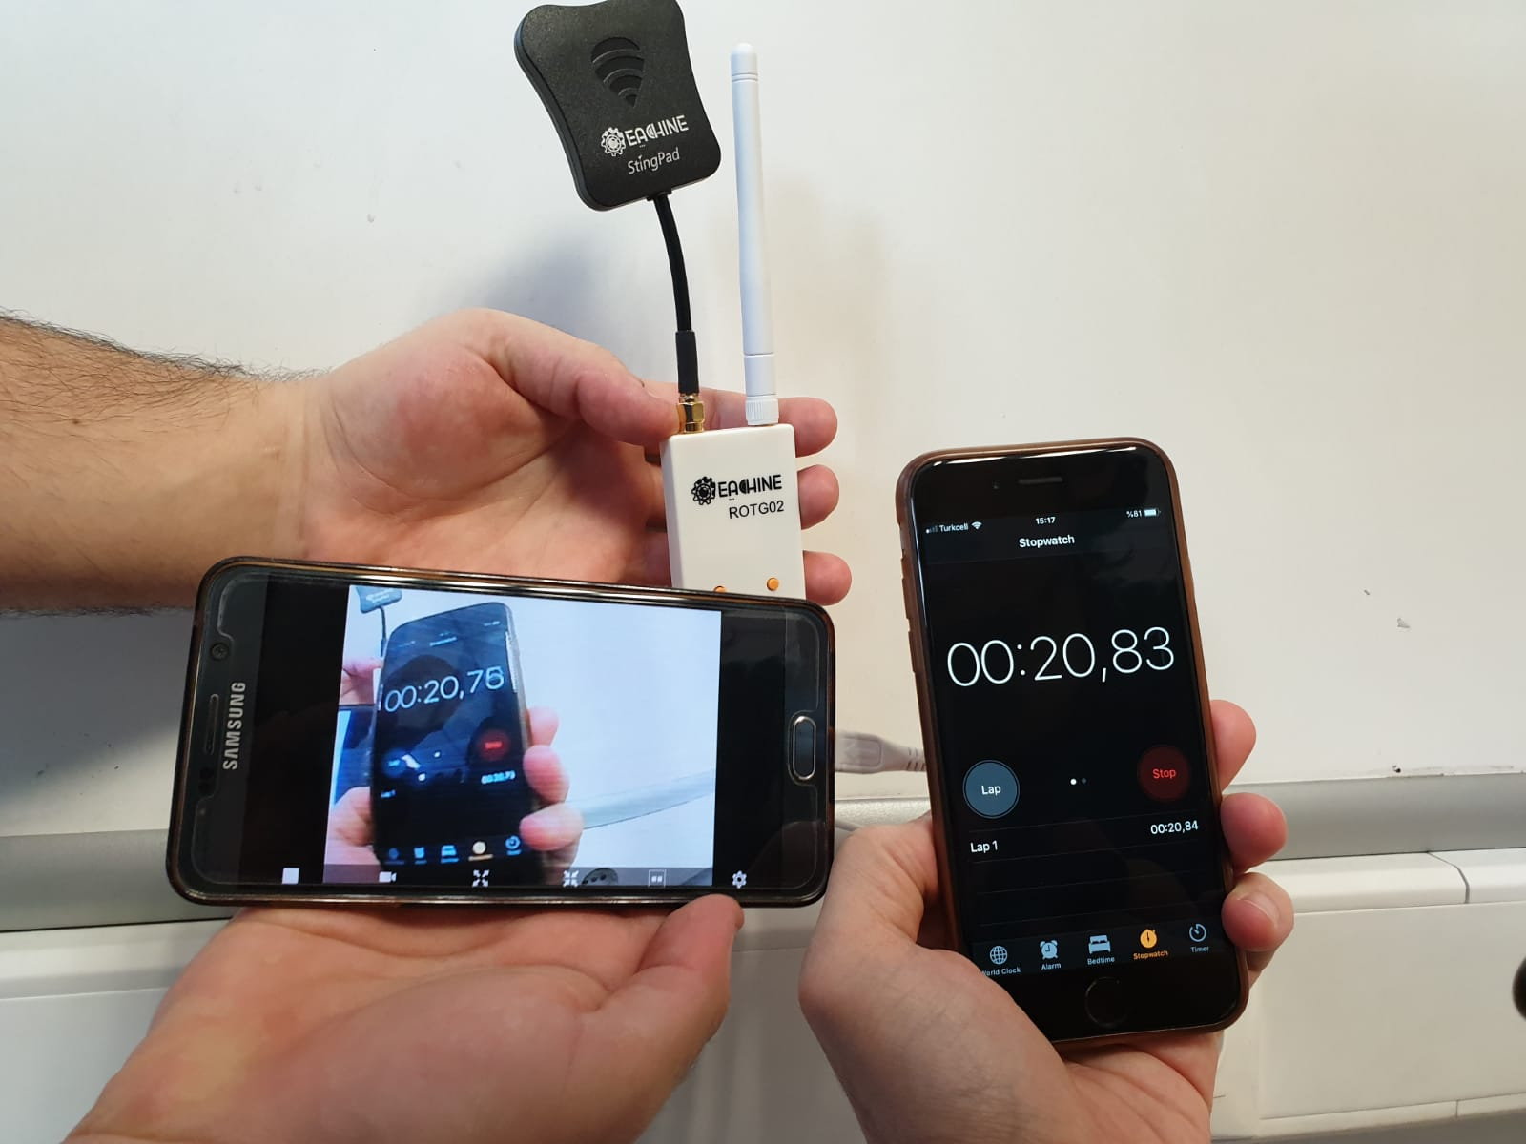
Test Results

Slide 7
Alternative Solutions
3G/4G modules
Upload and download video anywhere
Feature transmission
Image processing

